Slide 1
Security in wireless ad-hoc networks
Xinghan Li, Zepu Song, Chuanren Ma
CS-810
03/30/2017

Slide 2
Ad hoc networks are a new paradigm of wireless communication for mobile hosts.
The network is ad hoc because it does not rely on a pre-existing infrastructure, such as routers in wired networks or access points in managed (infrastructure) wireless networks.
Wireless mobile ad hoc networks are self-configuring, dynamic networks in which nodes are free to move.

Slide 3
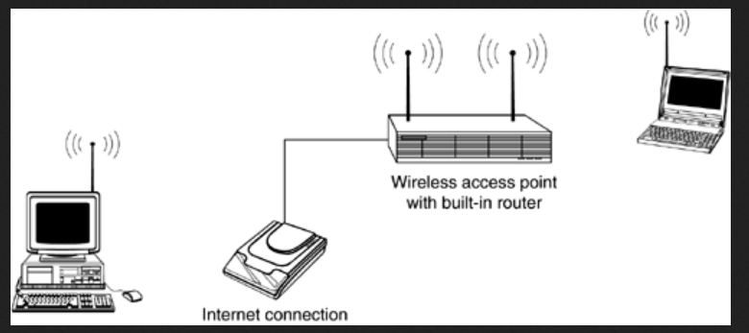
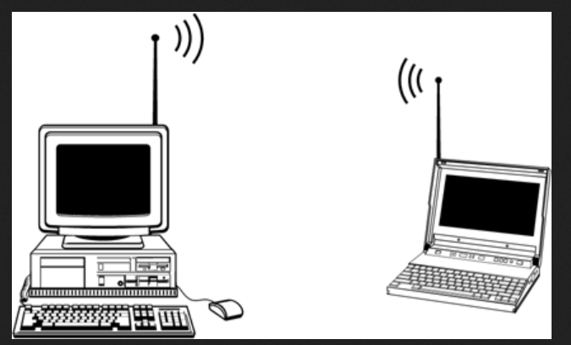
Infrastructure network
Ad hoc network
In infrastructure mode, every wireless device on the network links up with a central access point, which
usually is a wireless router.
An access point lets you easily expand a wired network with wireless capability.
Extend your wireless network's range. Placing an access point in between two wireless network adapters doubles their range.
Simple to set up. Plug in your wireless network adapters, configure the software, and you're off and running.
Inexpensive. You save the cost of purchasing an access point.

Slide 4
Node mobility in an ad hoc network causes frequent changes of the network topology.
Security. Wi-Fi devices in ad hoc mode offer minimal security against unwanted incoming connections.
Signal strength monitoring. The normal operating system software indications seen when connected in infrastructure mode are unavailable in ad hoc mode. Without the ability to monitor the strength of signals, maintaining a stable connection can be difficult, especially when the ad hoc devices change their positions.

Slide 5
Pros
Highly performing network
No expensive infrastructure must be installed
Use of unlicensed frequency spectrum
Quick distribution of information around sender
No single point of failure.
Cons
All network entities may be mobile ⇒ very dynamic topology
Network functions must have high degree of adaptability
No central entities ⇒ operation in completely distributed manner.

Slide 6
Mobile ad hoc networks (MANETs)
A mobile ad hoc network (MANET) is a continuously self-configuring, infrastructure-less network of mobile devices connected without wires.
Vehicular ad hoc networks (VANETs)
VANETs are used for communication between vehicles and roadside equipment. Vehicles are using radio waves to communicate with each other.
Smartphone ad hoc networks (SPANs)
SPANs leverage the existing hardware (primarily Bluetooth) in commercially available smartphones to create peer-to-peer networks without relying on cellular carrier networks, wireless access points, or traditional network infrastructure.
Internet-based mobile ad hoc networks (iMANETs)
iMANETs are ad hoc networks that link mobile nodes and fixed Internet-gateway nodes.
Military and tactical MANETs
Military MANETs are used by military units with emphasis on security, range, and integration with existing systems.

Slide 7
Security goals
Security is an important issue for ad hoc networks, especially for those security-sensitive applications. To secure an ad hoc network, we consider the following attributes: availability, confidentiality, integrity, authentication, and non-repudiation.

Slide 8
potential threats to wireless ad-hoc networks
Availability ensures the survivability of network services despite denial of service attacks. A denial of service attack could be launched at any layer of an ad hoc network. On the physical and media access control layers, an adversary could employ jamming to interfere with communication on physical channels. On the network layer, an adversary could disrupt the routing protocol and disconnect the network. On the higher layers, an adversary could bring down high-level services. One such target is the key management service, an essential service for any security framework.

Slide 9
Confidentiality ensures that certain information is never disclosed to unauthorized entities. Network transmission of sensitive information. Leakage of such information to enemies could have devastating consequences. Routing information must also remain confidential in certain cases, because the information might be valuable for enemies to identify and to locate their targets in a battlefield.
Integrity guarantees that a message being transferred is never corrupted. A message could be corrupted because of benign failures or malicious attacks on the network.

Slide 10
Authentication enables a node to ensure the identity of the peer node it is communicating with. Without authentication, an adversary could masquerade a node, thus gaining unauthorized access to resource and sensitive information and interfering with the operation of other nodes.
Non-repudiation ensures that the origin of a message cannot deny having sent the message. Non- repudiation is useful for detection and isolation of compromised nodes. When a node A receives an erroneous message from a node B, non-repudiation allows A to accuse B using this message and to convince other nodes that B is compromised.

Slide 11
Challenges
Use of wireless links renders an ad hoc network susceptible to link attacks ranging from passive eavesdropping to active impersonation, message replay, and message distortion. Eavesdropping might give an adversary access to secret information, violating confidentiality. Active attacks might allow the adversary to delete messages, to inject erroneous messages, to modify messages, and to impersonate a node, thus violating availability, integrity, authentication, and non-repudiation.
Ad hoc network may consist of hundreds or even thousands of nodes. Security mechanisms should be scalable to handle such a large network.

Slide 12
Nodes, roaming in a hostile environment (e.g., a battlefield) with relatively poor physical protection, have non-negligible probability of being compromised. Therefore, we should not only consider malicious attacks from outside a network, but also take into account the attacks launched from within the network by compromised nodes. Therefore, to achieve high survivability, ad hoc networks should have a distributed architecture with no central entities.
An ad hoc network is dynamic because of frequent changes in both its topology and its membership. Trust relationship among nodes also changes. Nodes in an ad hoc network may dynamically become affiliated with administrative domains. Any security solution with a static configuration would not suffice. It is desirable for our security mechanisms to adapt on-the-fly to these changes.

Slide 13
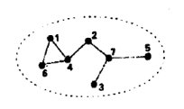
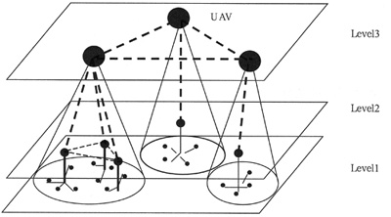
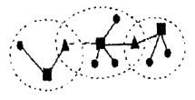
2 main structures
Fully distributed control structure
Hierarchical distributed control structure
Notes:
Both of them don’t have a central nodes() 1st one all in the same range , 2nd one might be need to communicate through the 3rd nodes because of some Geography factor

Slide 14

Secure Routing
Routing protocols for ad hoc networks are still under research.
There is no single standard routing protocol for ad hoc networks.

Slide 15
2 principles to follow
Distribution of trust
Take advantage of redundancies in the network topology to achieve availability
Notes:
Since there is no central nodes, All the nodes are core nodes, all the nodes are important and necessary. Some of them might be false routing nodes (attacker disguised as a real nodes)

Slide 16
2 sources of threats to routing protocols
Internal attackers
External attackers
Compromised nodes (Internal accident)
External accident
Notes:
Since ad hoc networks are used in special occasions(for instance, military), it’s not like a database ,we don’t need to care about the internal attackers or external accident

Slide 17
The problem we face
Guaranteed the security of routing protocol
Each node act as both host and router
To solve it:
asymmetric cryptographic algorithm (RSA)
Notes:
That’s what we talk in the 2nd week course, which would help us to prevent from external attack

Slide 18
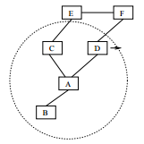
What about the compromised nodes?
Ad hoc networks must handle outdated routing information to accommodate the dynamically changing topology.
Diversity coding takes advantage of multiple paths in an efficient way without message retransmission.
Notes:
Retransmission would waste a lot of time and resources(for instance, Dos attack, denial of services attack)

Slide 19
Diversity coding
The basic idea is to transmit redundant information through additional routes for error detection and correction. For example, if there are n disjoint routes between two nodes, then we can use n−r channels to transmit data and use the other r channels to transmit redundant information. Even if certain routes are compromised, the receiver may still be able to validate messages and to recover messages from errors using the redundant information from the additional r channels.
Notes:
We need to remove C if it breaks down

Slide 20
conclusion
Ad Hoc network face security problem from both external and internal
For external attackers, RSA would be useful
For compromised codes, Diversity coding are necessary to handle outdated routing information

